Slide 1
THE BEST PLACE
FOR TWO
2019

Slide 2
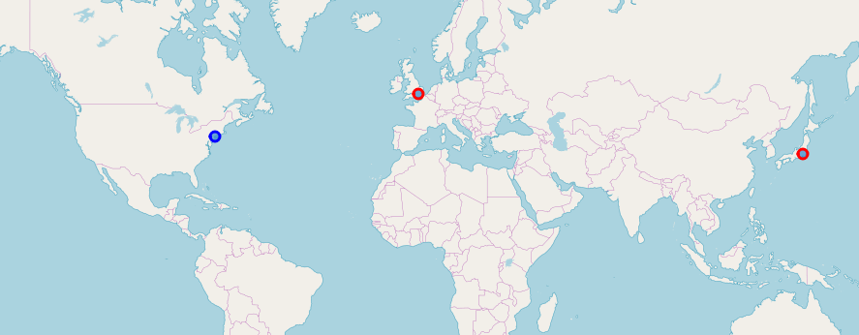
Introduction/Business Problem
It is common when two or more persons (e.g. a family) look for the good place in the new unknown city. E.g. he is from Toronto, she is from New York, and they want to live together in Paris. What should they do?

Slide 3
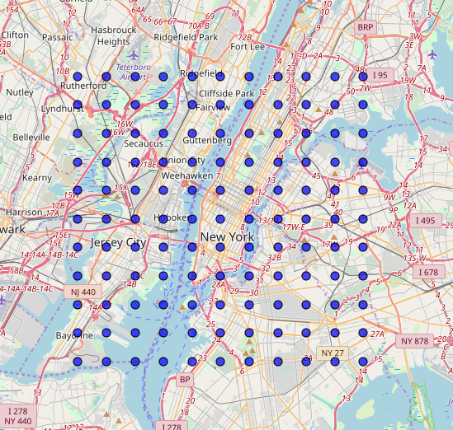
Data
We will use Foursquare data to retrieve place information.
Plus we will try to use different functions to merge interests of the persons.

Slide 4
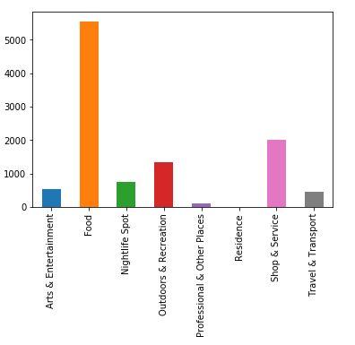
Data cleaning
Some categories have zeros only, some are too big, so we need data normalization.

Slide 5
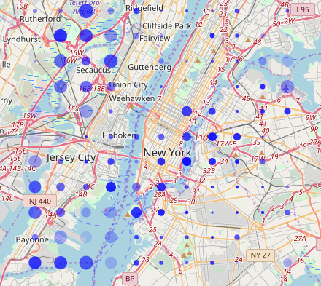
Results
Let me to like Hyde Park in London and you to like Tokyo.
And we relocate to New York.
Where should we live?
Big circles shows my interest.
Solid circles shows yours.

Slide 6
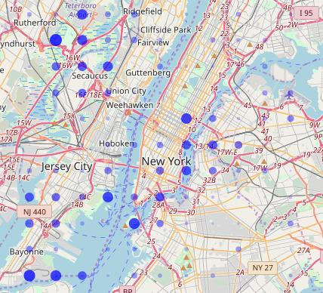
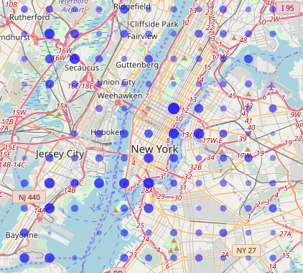
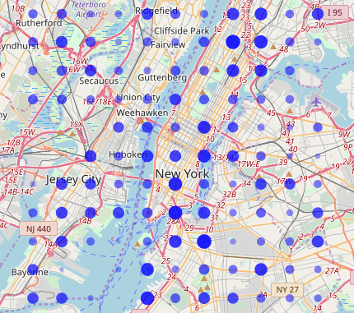
We can merge results for every person and show the united figure for both
Hyde Park & Tokyo
Hyde Park & Moscow
Moscow & Tokyo

Slide 7
Conclusion
Results shows that some geographical data, e.g. Foursquare API, can be used to help people to find places that are similar to the places these people like.
Additional data what precisely people like about the places can make the model better.

